Slide 1

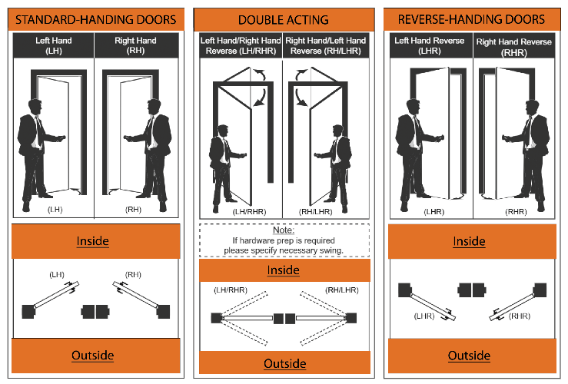
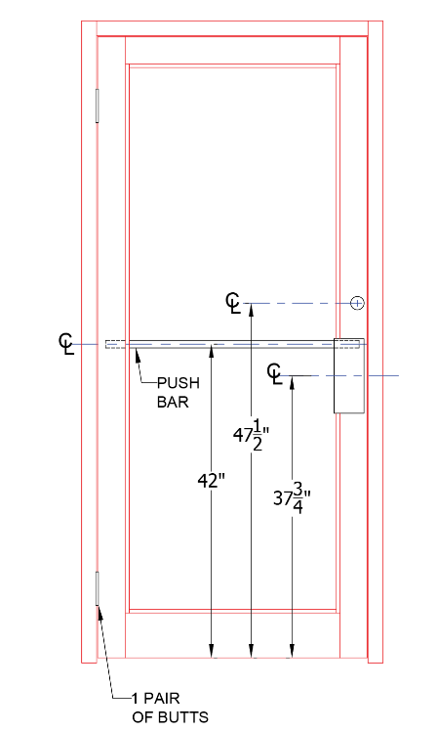
ST O R E F R O N T S & E N T R A N C E S Y S T E M S
ATLAS ARCHITECTURAL METALS,INC. 11940 | BRITTMOORE PARK DR.Toll | PH: (713) 869-9551 www.atlasarchmetals.com
D O O R O R D E R F O R M
CUSTOMER INFORMATION
CUSTOMER
DATE
CONTACT EMAIL
CUSTOMER PO.
PHONE FAX
JOB NAME
ADDRESS
PREPARED BY
CITY STATE ZIP
DOOR OPENING
QTY | HAND | MK# | WIDTH | HEIGHT
FINISHES
BLK/BRZ ANODIZED
CLEAR ANODIZED POWDER COATING
HINGE (NOTE: Doors over 96" tall require 1 additional Hinge. Doors over 108" tall require 2 additional hinges.
OFFSET PIVOT
INTERMEDIATE PIVOT
ADD PER DOOR
BUTT HINGE 1-1/2" PR CENTER HUNG
CONCEALED CONTINUOUS HINGE
STILE
NARROW MEDIUM
WIDE
(2-1/8")
(3-3/4")
(5")
TOP RAIL
STANDARD
OTHER
HARDWARE
CVR PANIC
RIM PANIC
SURFACE MOUNTED CLOSER
CONCEALED OVERHEAD CLOSER
BOTTOM RAIL
STANDARD
A.D.A (10")
DOOR SWING CHART
DOOR GLAZING
1/4"
1" 9/16”
LOCK
3 POINT LOCK
FLUSH BOLT
HANDLE
PUSH
PULL
LADDER PULL 48"
HLSI
HRSI HLDA
HRDA RH
LH
FRAME PROFILE | FRAME OPTIONS | TRANSOM OPTIONS | THRESHOLD OPTIONS STANDARD (1/2") 5"HP
1-3/4" X 4-1/2" | WITH FRAME | STANDARD
2" x 4-1/2" | NO FRAME | NO TRANSOM
THERMAL |  | CUSTOM HEIGHT
(OUTSIDE VIEW)

